Slide 1
Europe Day
Gergana 6g 6nomer

Slide 2
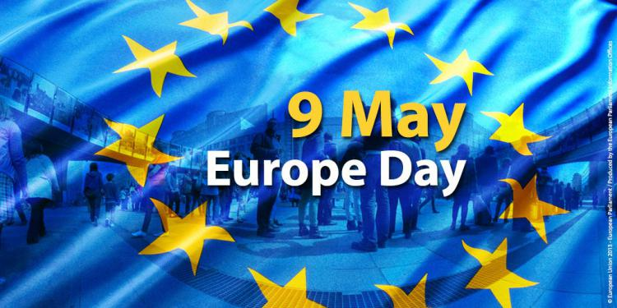
Europe Day history
09 May is Europe Day and it commemorates the first move towards the creation of what has today become the European Union.
This celebration acknowledges the importance of the role Robert Schuman played in the beginning of the European Coal and Steel Community, and the process of integration which this instigated. Schuman and Monnet were indeed visionaries and played a key part in the official history of European integration emerging from the fragile post war Europe and this is why 09 May is Europe day.

Slide 3

Together
Many people may not know that today is a day to celebrate union and peace, but should. Even knowing that Europe Day seems like a continental celebration, the date has been becoming popular to not only embrace Europeans, but also immigrants and discuss fraternity.
In accordance with Europe Union, "Europe Day held on 9 May every year celebrates peace and unity in Europe. The date marks the anniversary of the historical 'Schuman declaration'. At a speech in Paris in 1950, Robert Schuman, the then French foreign minister, set out his idea for a new form of political cooperation in Europe, which would make war between Europe's nations unthinkable". The history says that his idea was to create a European institution that would pool and manage coal and steel production. A treaty creating such a body was signed just under a year later. Schuman's proposal is considered to be the beginning of what is now the European Union.

Slide 4



Saying
Unit makes strength
Together we are stronger
One for all, all for one

Slide 5
Thanks for watching
Be Happy
#stayHome

