Slide 1
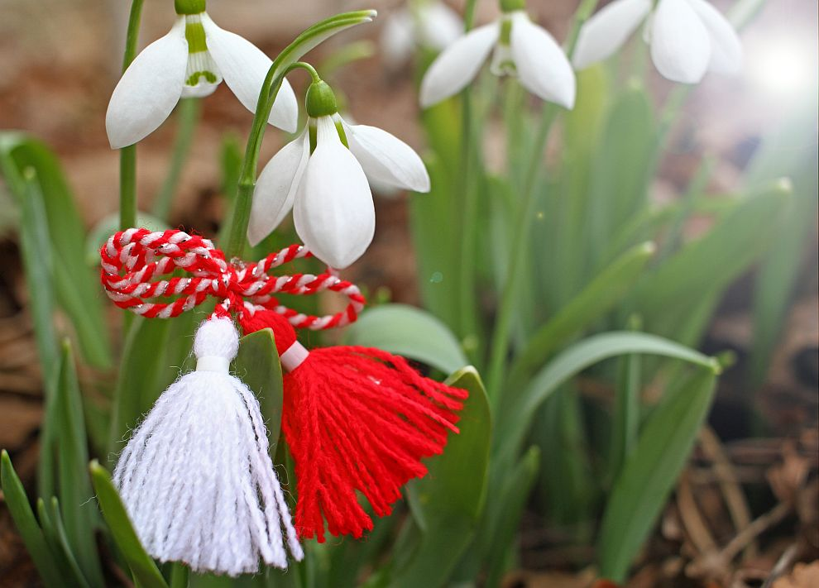
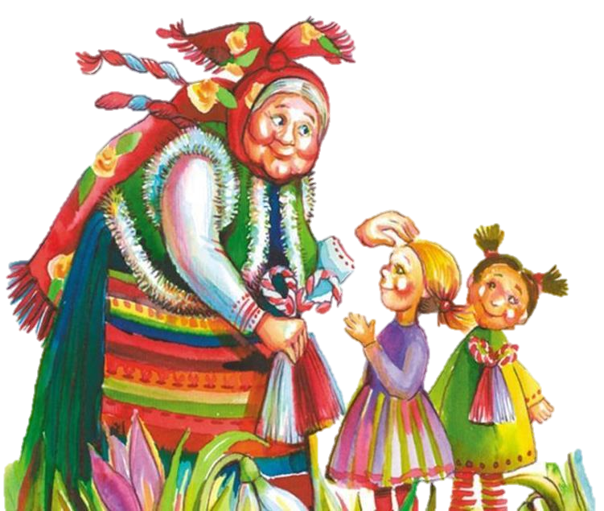
Baba Marta
Baba Marta
Made from: Steliana Petrova, Georgi Petrov, Aleksandra Vladimirova, Galin Stavrev, Liubena Peeva, Elena Peeva

Slide 2
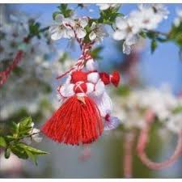
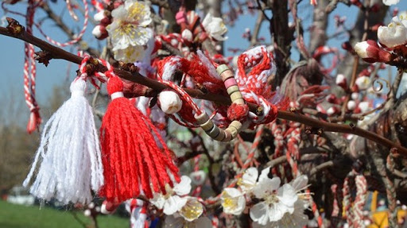
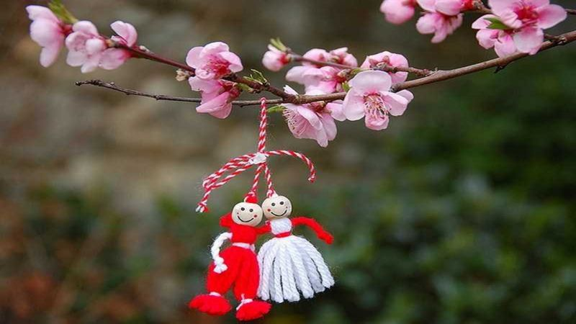
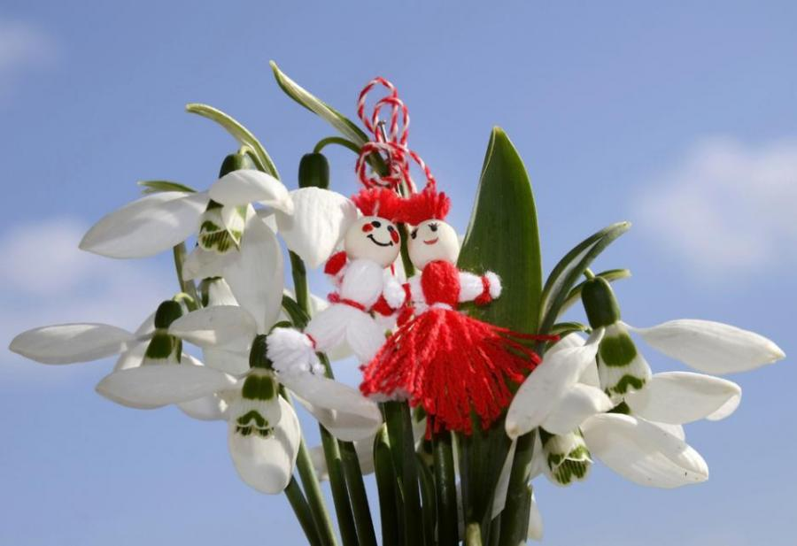
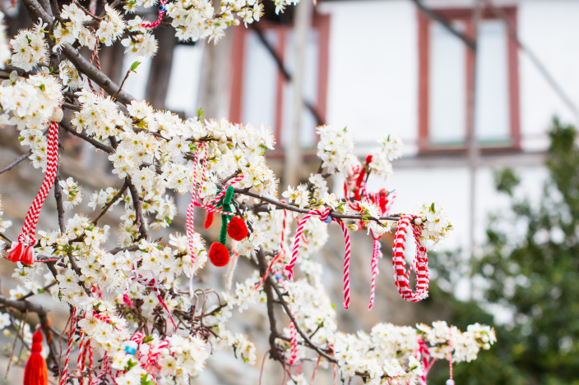
Legend
One of the legend about Baba Marta tells that in the morning of 1st of March the housewives have to sweep their homes and fire the gathered trash.

Slide 3
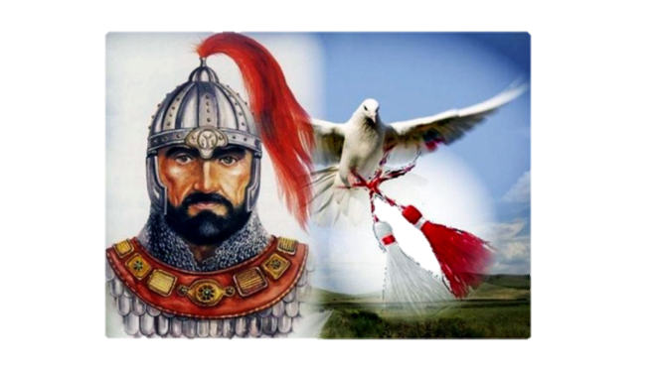
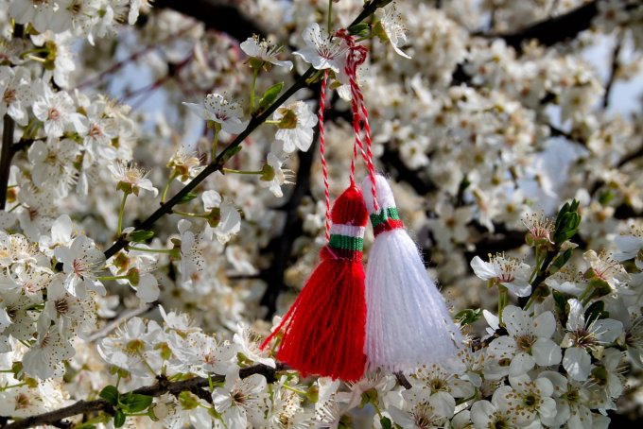
Khan Asparuh defeated the Byzantines army and wrote a letter to his sister about victory. He tied the paper on the leg of a bird with white thread. While the bird was flying it was stuck and wounded by the Byzantines soldiers. Although the animal succeeded to reach the Bulgarian camp and to bring the good news. The white thread colored with the birds blood. It was reached to his sister on 1st of March and that is the beginning of the tradition- all the Bulgarians to give one another white- red martenitsi for healt.

Slide 4

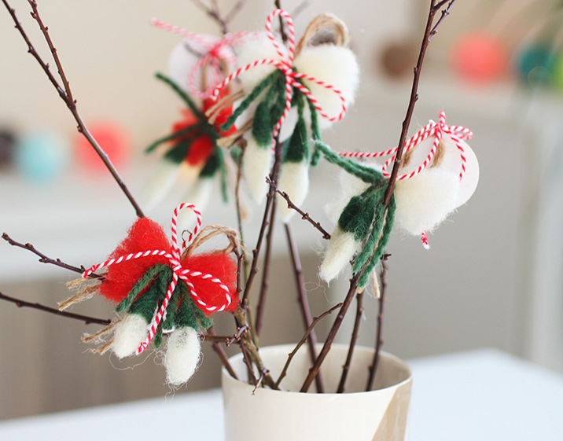
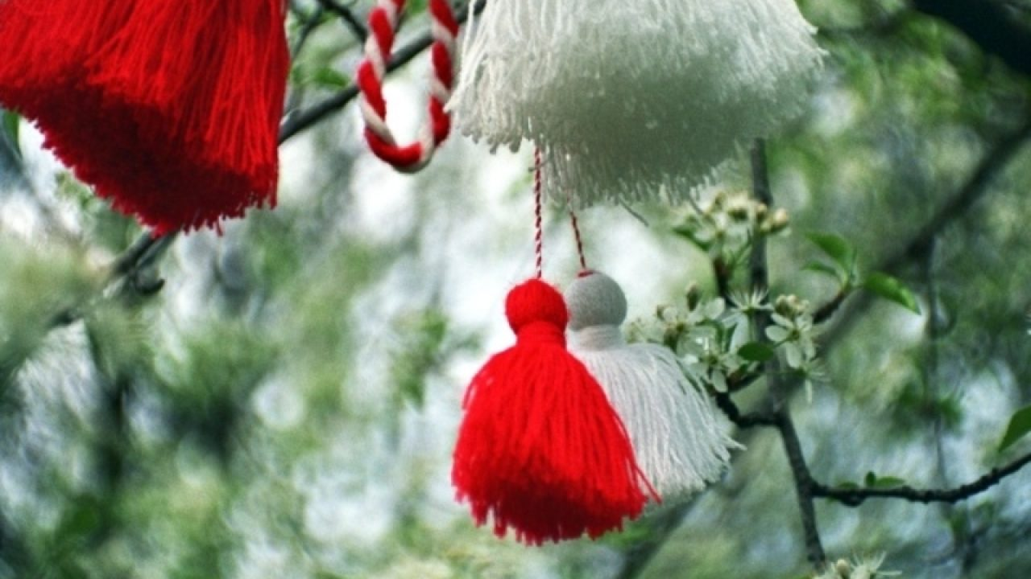
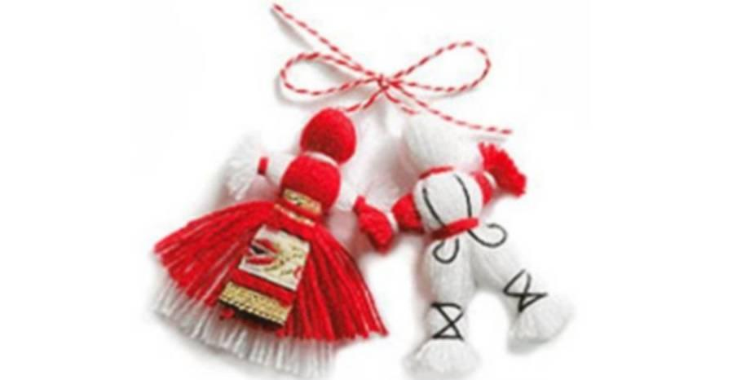
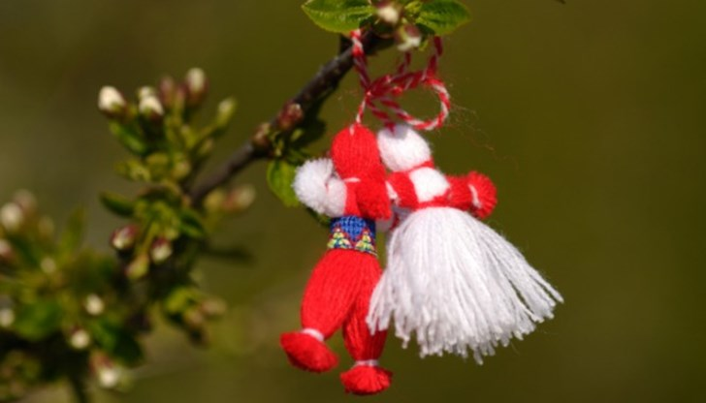

Slide 5
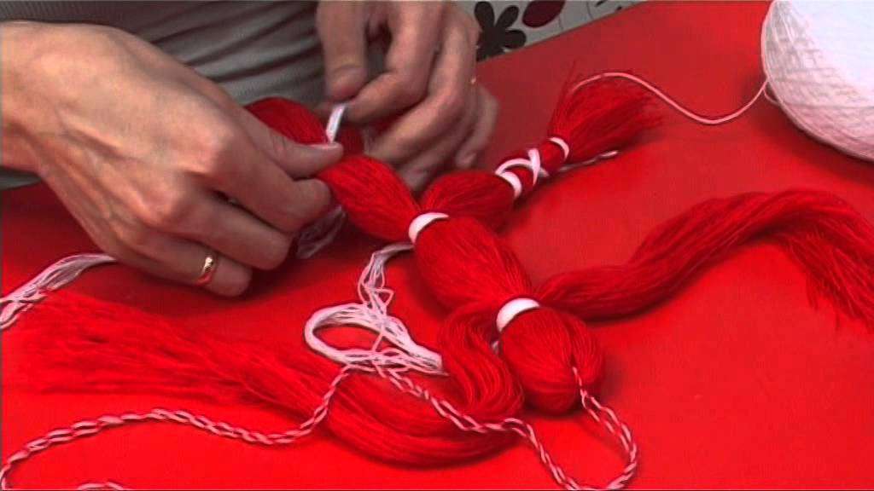
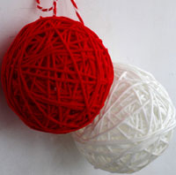
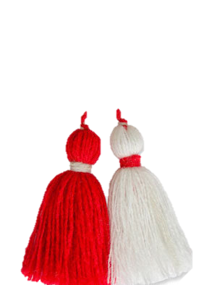
An old Bulgarian tradition is making martenitsi with red and white twisted sheep thread. They have to be tie on the wrist, on the neck or on the chest.

Slide 6
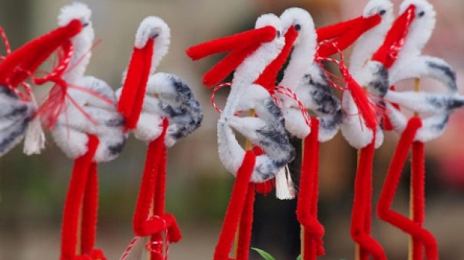
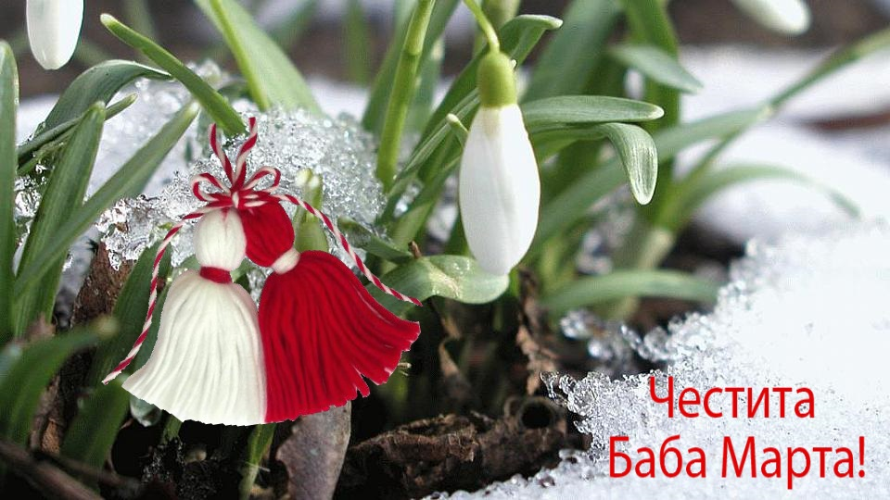
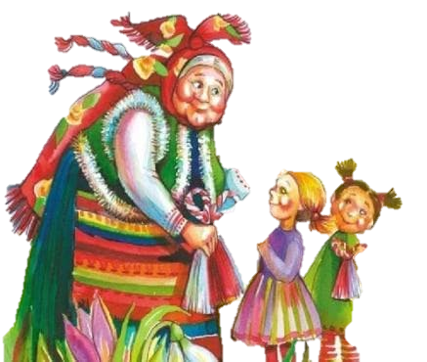
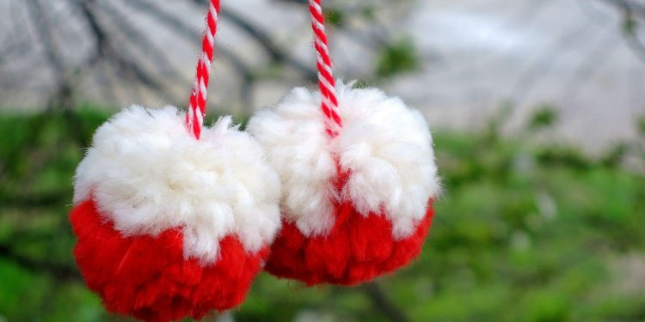

Slide 7
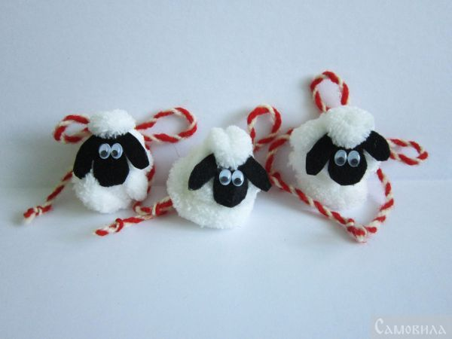
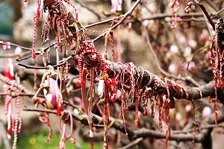
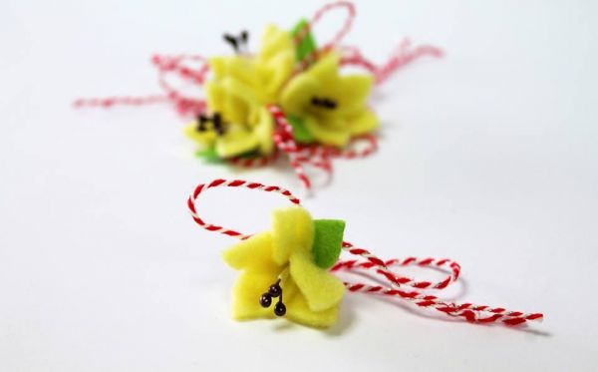
At first that was being done just for kids, lambs and bloomed threes, later for young girls and boys and now even grandparents. Somewhere they are called “ kitchenica’’ or ‘’kitichki”. They have to be worn until the storks arrive, or three bloom, and that means all the evil will go away, and it is the end of the cold weather.

Slide 8
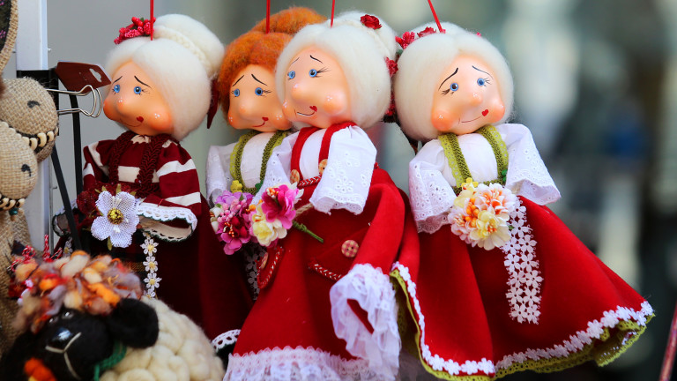
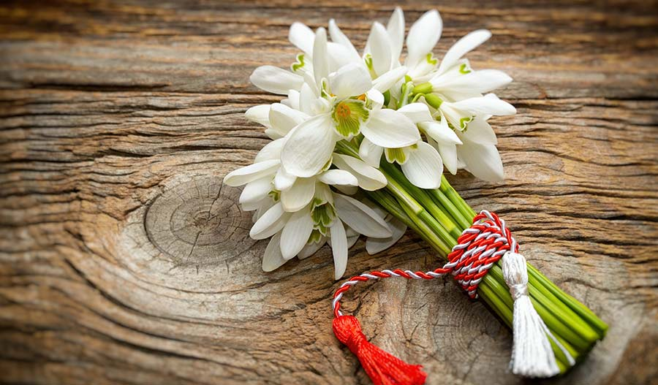
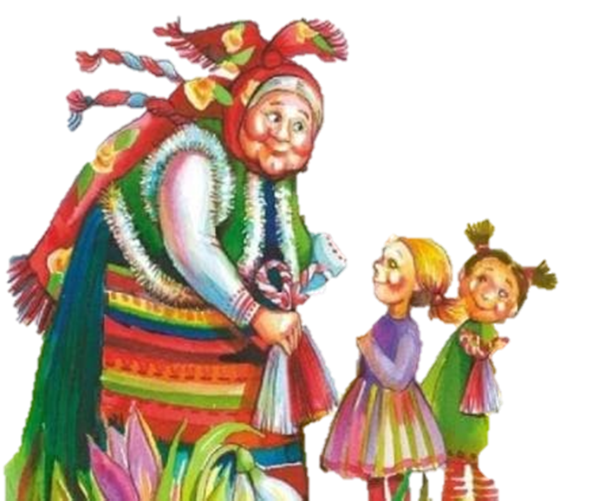
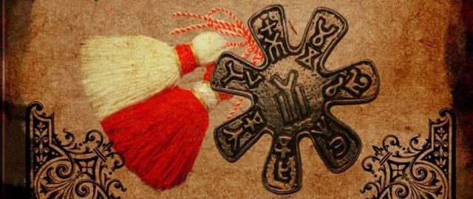

Slide 9
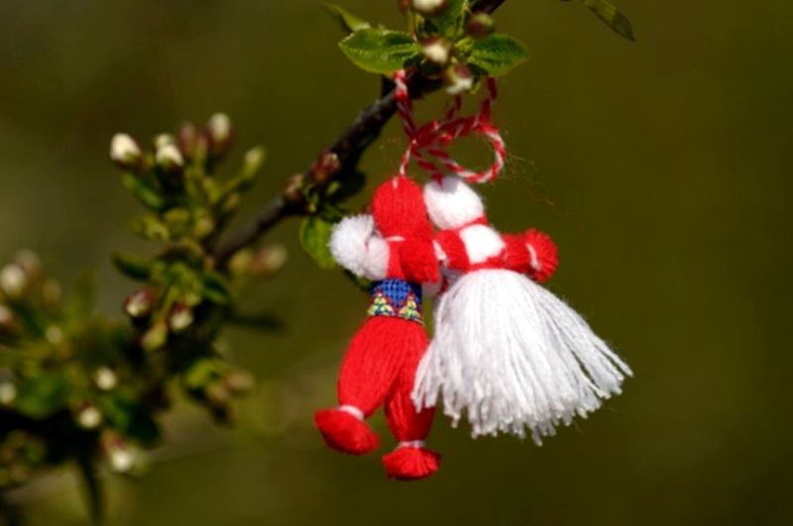
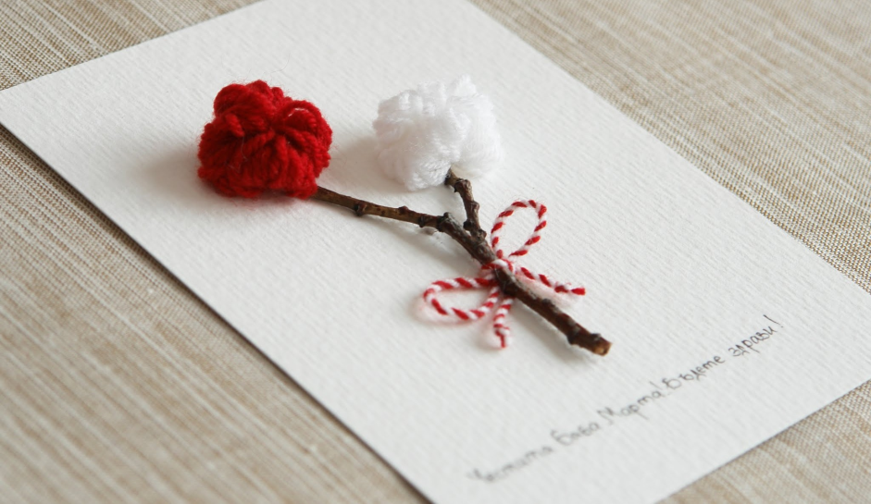
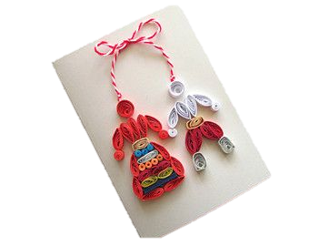
The colored red- white thread becomes a symbol of the friendship between Slavs and Bulgarians, a symbol for health and happiness. The white color means cleanliness and the red one- warmth and love. In newer days the origin of martenitsi hanged on the trees was related with rebels, who where going in the mountains to be fight for the liberty white color- hunger for freedom and the red one- fight and loosing blood.

Slide 10
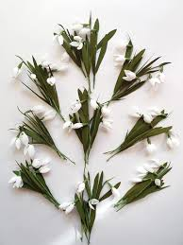
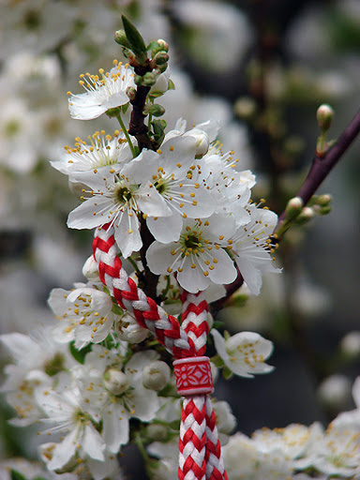
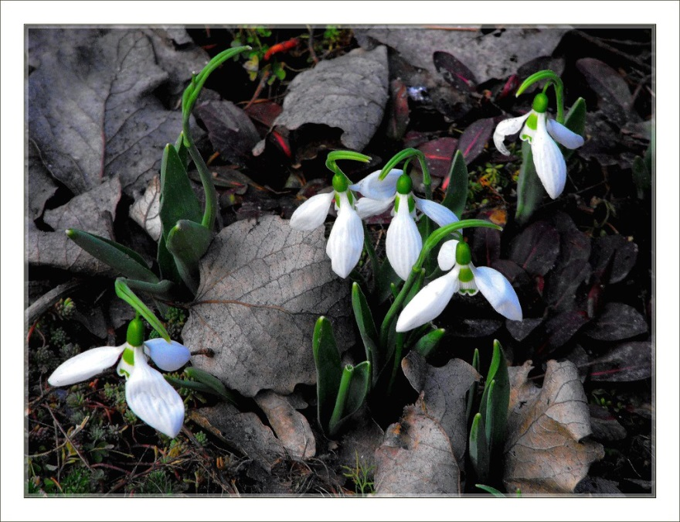
Thanks for watching

