Slide 1

Christmas Season traditions in my country and town

Slide 2
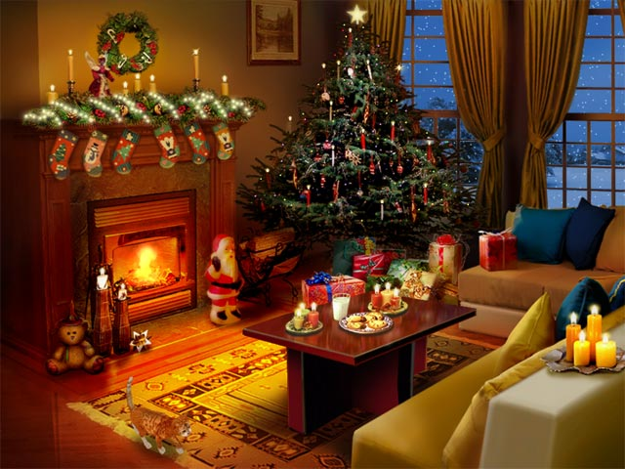
As in other countries, a Christmas tree is typically set up and the whole house is decorated. The local name of Santa Claus is Djado Koleda
(or ‘Grandfather Christmas’).

Slide 3
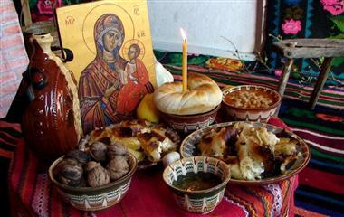
Christmas Eve
We decorate our houses with pine sticks, tinsels, Christmas lights, but there is also a special place for the family icons – a Holy Image.

Slide 4
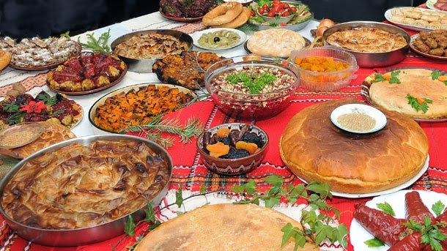
Christmas Eve
In Bulgaria,
Christmas (Koleda, or more formally ‘Nativity of Jesus’) is celebrated on 25 December and is preceded by Christmas Eve (Badni vecher).
Traditionally, only an odd number of simple dishes are prepared on that evening.

Slide 5
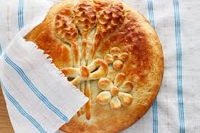
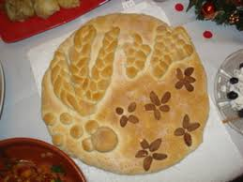
A traditional round loaf or pita is usually the center of the table. The pita is broken into pieces by the head of the family, and a piece is given to each family member, a valuable possession, and a piece for God. A coin is hidden inside the pita and whoever gets the coin will have luck, health and prosperity in the coming year.

Slide 6
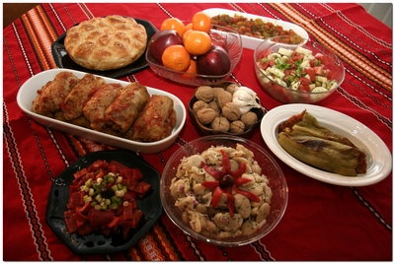
Christmas Eve
After the dinner everyone has to choose a whole walnut. Then we brake it, and if it is full and fresh, our year will be rich and healty!

Slide 7
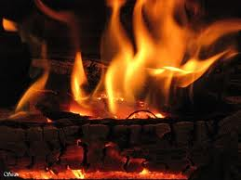
Christmas Eve
On that day, a Badnik (which comes from the word ‘future’), namely a log from a young, strong oak tree is brought into the house and placed in the fire. The Badnik is a symbol of people’s hope that the night will bring prosperity to the home in the future.

Slide 8
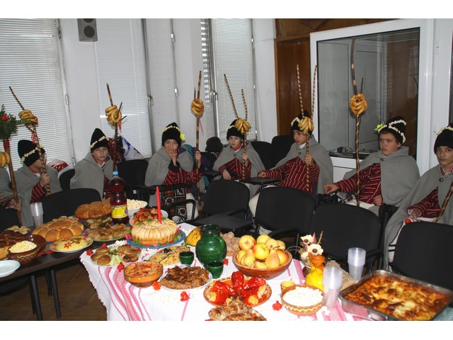
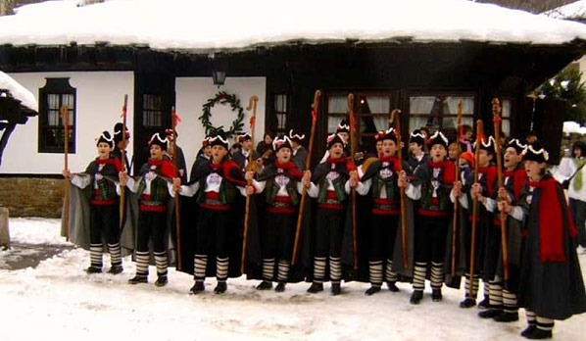
One of the Bulgarian Christmas traditions is koleduvane. It involves men carollers (koledari) visiting the neighbouring houses from midnight on Christmas Eve, singing carols to wish health, happiness and prosperity.Everyone is waiting for them!

Slide 9
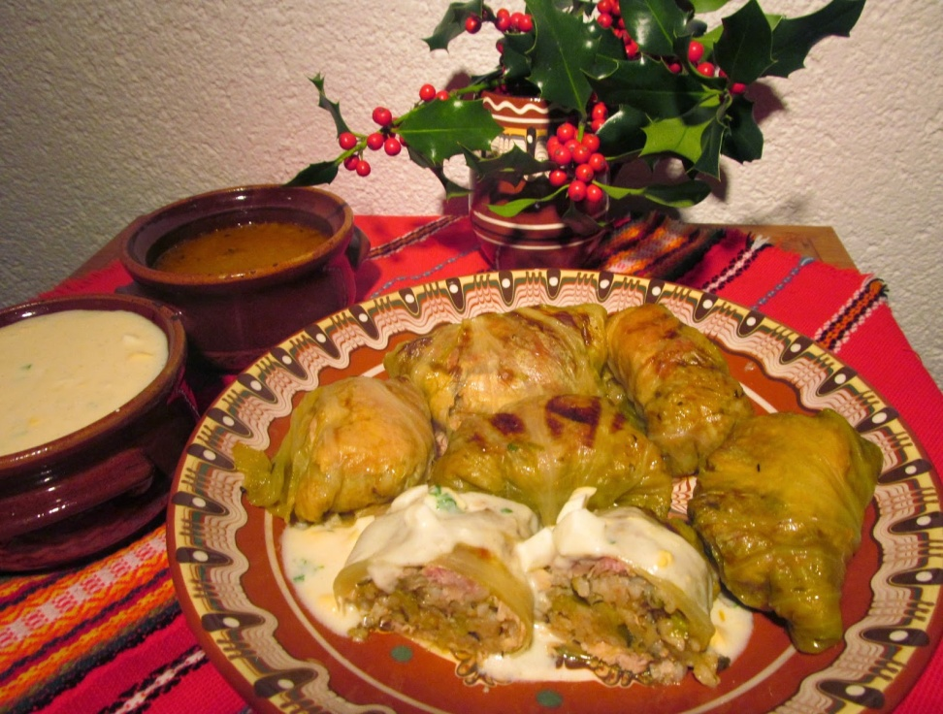
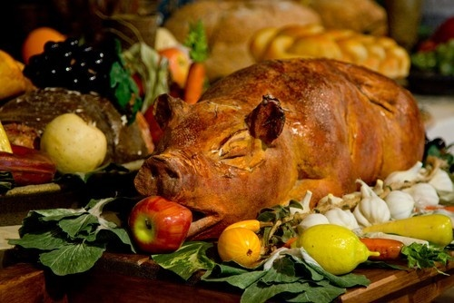
On Christmas Day all members of the family gather together and celebrate Christmas. The Christmas table have to be rich and there are two traditional meals: cabbage sarma with meat and roasted pork.

Slide 10
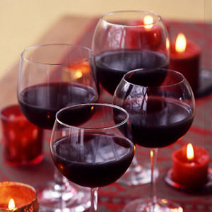
Christmas Day
On the table are served traditionaly red wine – usually homemade, and typical Bulgarian spirit – rakia.

Slide 11
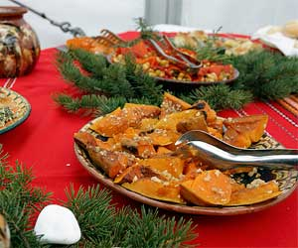
Christmas Day
The dessert is delicious baked pumpkin with honey and cinnamon, baklava or pumpkin pie.

Slide 12

Merry Christmas and a very Happy New Year from 5‘d’ class

