Slide 1

9 May- Europe day

Slide 2

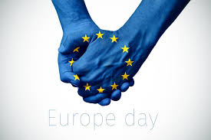
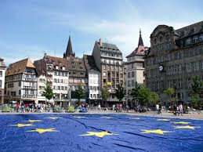


Slide 3
On this day we celebrate the Europe day! On this day we celebrate our continent day- Europe! Stay positive, make your friends and family happy. We don’t have time to be sad. Smile, laugh and live your best live☺

