Slide 1


Shopska salad
Antonia Atanasova 5d class

Slide 2
This is Bulgaria's most famous dish and national salad. The ingredients used were chosen in part because they resemble the three colors of the Bulgarian flag, and this would evoke a national sentiment

Slide 3
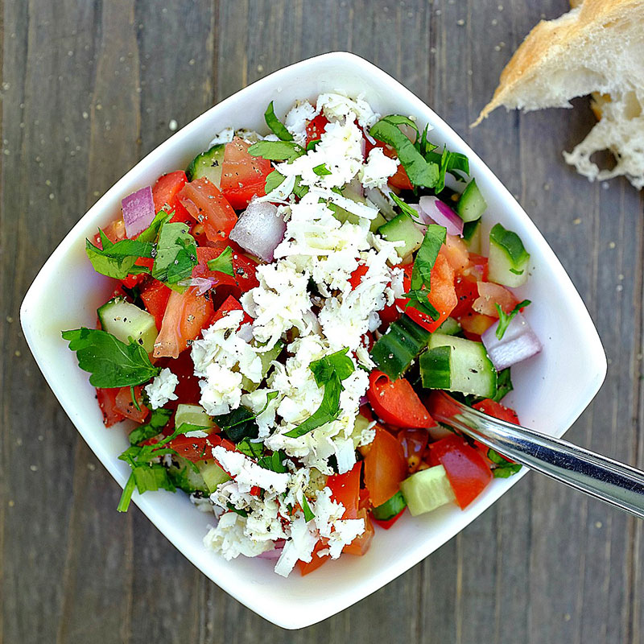
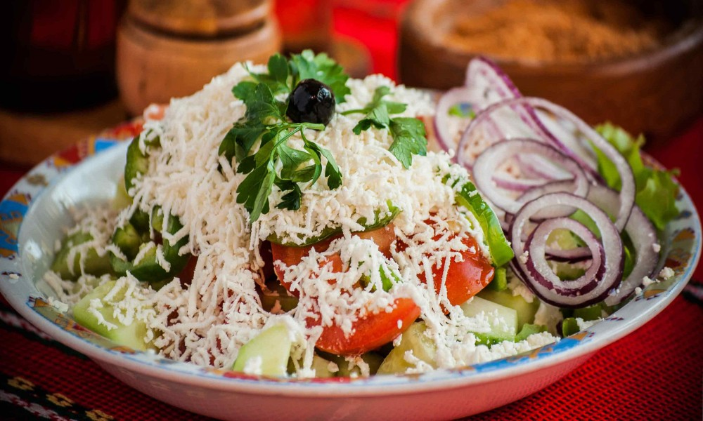
Though the salad's name comes from the region called Shopluk, in fact, it was invented around 1955 in a Black Sea resort near Varna, called Druzhba. It can be found in one of the first state-approved repertoires from 1956

Slide 4
ingredients
- tomatoes - vinegar
- cucumber - parsley
- onion - olive
- cheese - pepper
- salt
- olive oil

Slide 5
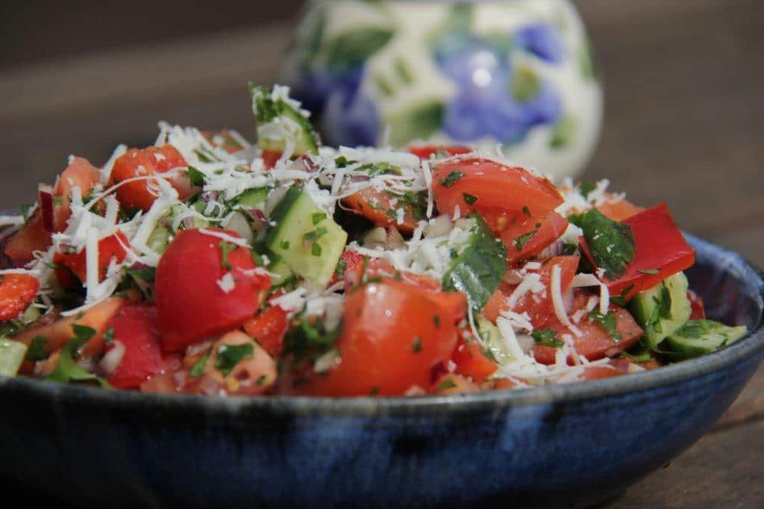
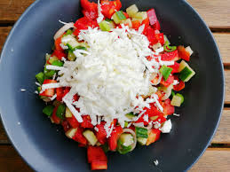
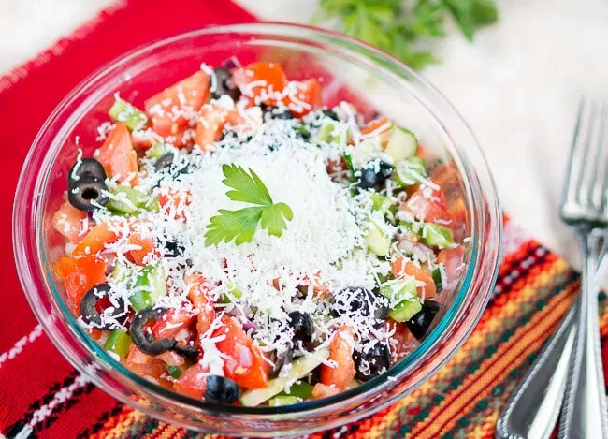

Slide 6
THANK YOU

