Slide 1
How to make
Shopska salad
By: Jordan Genkov Vd, № 13

Slide 2
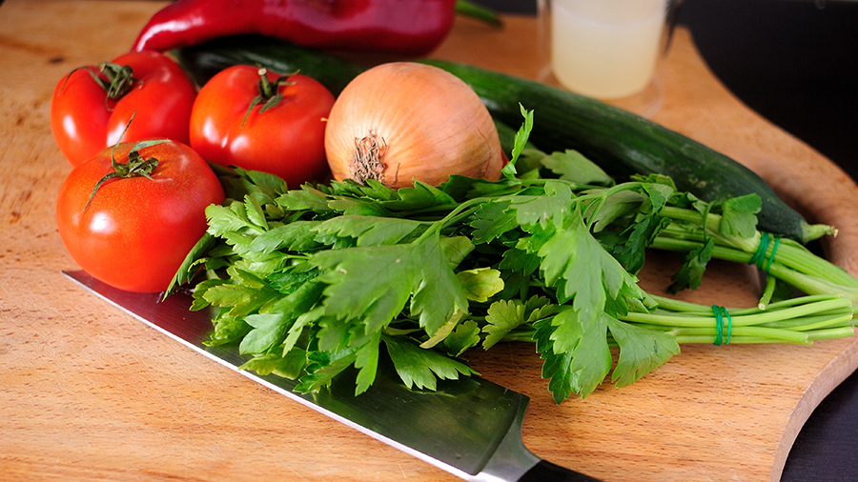
Shopska Salad
Shopska salad is prepared from chopped tomatoes, cucumbers, roasted peppers, onions, fresh parsley and grated white brined cheese.

Slide 3

…
Season with a dressing of vegetable fat (oil or olive oil) and optionally with wine or apple cider vinegar. If desired, hot pepper can be added.

Slide 4
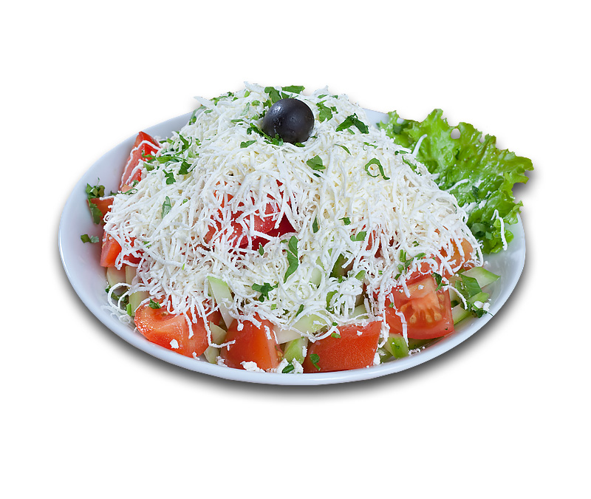
Garnish on top of the grated cheese with a stalk of fresh parsley, black olives or a small hot pepper.

Slide 5
…
Enjoy!

