Slide 1
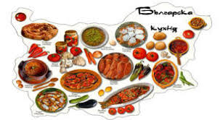
Bulgarian tradiciolnal dishes

Slide 2
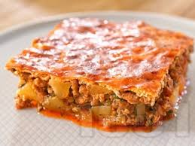
Musaka
There are many recipes for moussaka, sometimes without sauce, sometimes with other vegetables. Zucchini, potatoes and / or mushrooms can be used. There is also a lean version of moussaka without bechamel sauce and without meat - only vegetables, using minced eggplant, tomato sauce and breadcrumbs instead of minced meat. In some countries, such as northern Macedonia, a layer of fried sliced ​​potatoes is placed at the bottom.

Slide 3
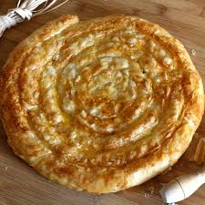
Banica
Mixed type pies are several varieties. The most popular is called a wedge. It is prepared by folding the square crusts diagonally and placing stuffing between the hem. The wedge can be not only triangular, but in the shape of a semi-ellipse or semicircle. The mantle is similar to a wedge, only it is made of a crust that is twice the size of the container in which it is lined, and after the filling is placed, the part that protrudes beyond the tray is folded and the crust is stretched to completely cover the filling. Both the wedge and the mantle are usually made with only one thicker dough crust, so often

Slide 4
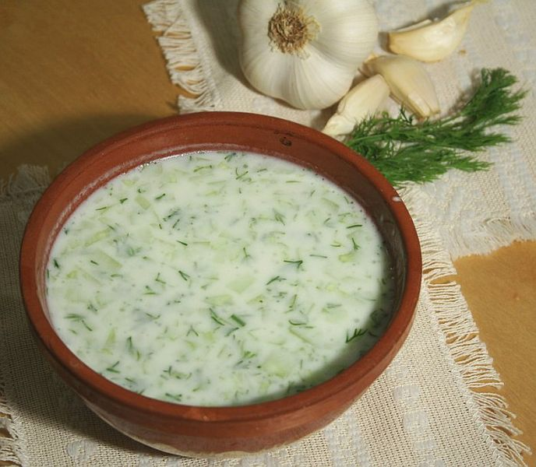
TARATOR
Tarator is a type of cold milk soup, traditional in Bulgarian cuisine, made from yogurt, water, finely chopped or grated cucumber, oil or olive oil, salt, dill and crushed, crushed or finely chopped garlic, which are mixed and stirred. If desired, crushed walnuts can be added to the mixture prepared in this way. This form of tarator appeared in Bulgaria in the middle of the XX century. Until then, this name

Slide 5
Vasilen Kirilov 5d

