Slide 1
Tarator
Made by Veliana Doncheva
5d class

Slide 2
Components
Yoghurt
Cucumber
Dill
Garlic
Water

Slide 3
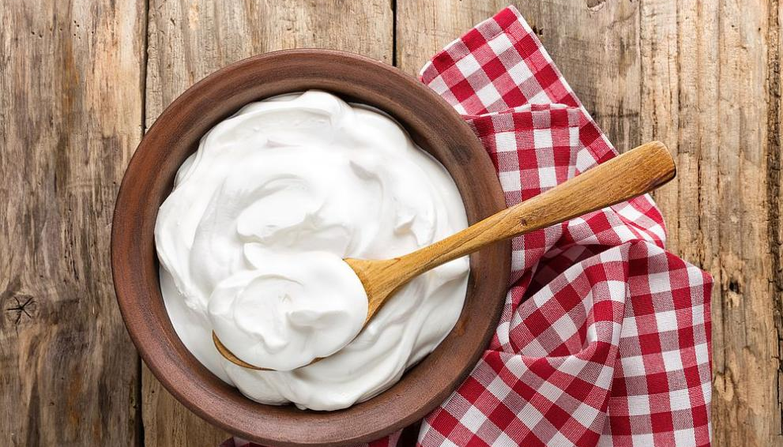
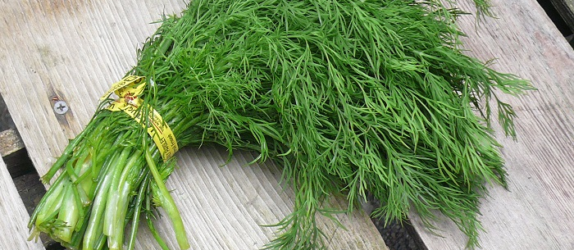
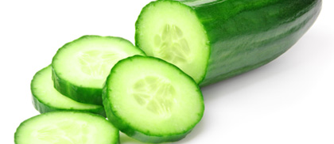
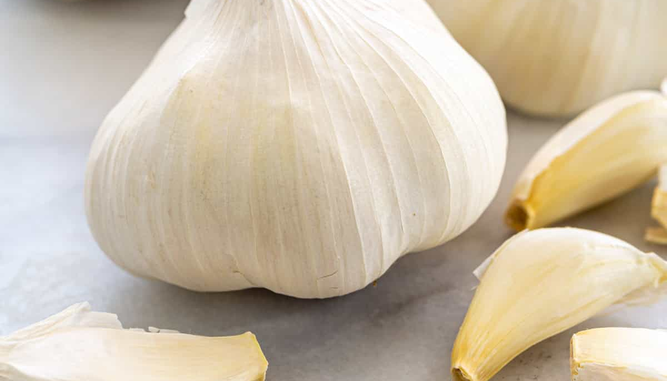

Slide 4
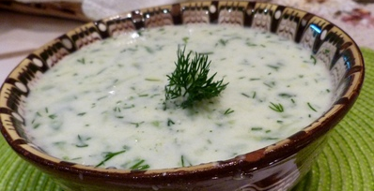
AND THIS IS THE result

Slide 5

Thanks for watching

