Slide 1
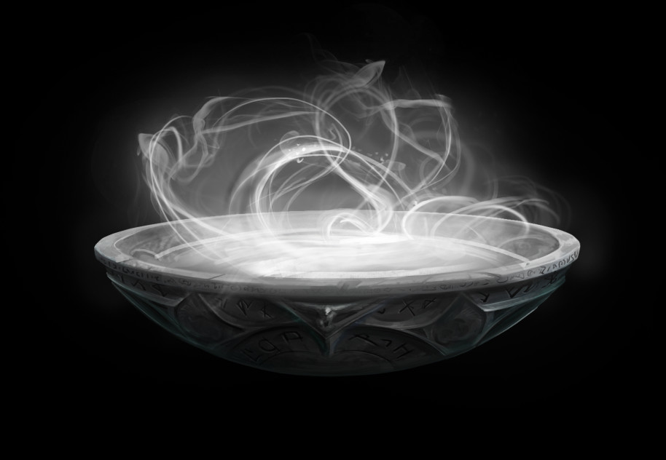
Bullying in Harry Potter
J. K. Rowling illustrates the terrible struggles many of us face; among them, bullying and prejudice, which are arguably the main themes of the series.
The pensieve

Slide 2
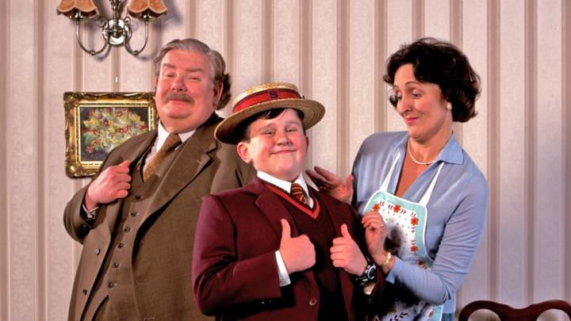
How do you know «Harry Potter» saga?
Can you describe these characters?
Can you recap briefly the plot?
Harry Potter, a young wizard, was orphaned at the age of 1 by a dark wizard, Lord Voldemort, who killed Harry’s parents and tried to kill Harry as well. Harry is then sent off to live with his abusive relatives, the Dursleys: Uncle Vernon, Aunt Petunia, and his cousin, Dudley. For the next 10 years, Harry lives in a kind of hell – his aunt and uncle are starving him, essentially making him into their servant, while Dudley and his friends bully him, chase him around the school, threaten him, and beat him up. On his 11th birthday, Harry learns that he is a wizard — something his relatives were trying hard to stomp out of him and goes off to study magic at Hogwarts School of Witchcraft and Wizardry.

Slide 3

Which are the main Reasons for Bullying?
Throughout the series, we find numerous examples of bullying, including the Dursleys, the Malfoys, Snape, Umbridge, and Voldemort. Commonly observed reasons for bullying include:
jealousy, low self esteem
being bullied by others, history of trauma
Antisocial Personality Disorder.
Can you match the reasons above with the characters?
https://www.youtube.com/watch?v=tu4_BdAEhe4
All go to different lengths and all have different origins, yet there is one thing they all have in common: the “Us vs. Them” attitude.
Having biases against other groups is related to self-esteem, the superiority of one’s group over another can lead to temporary increases in self-esteem. We see examples of this, specifically in trying to put down other group members, in all the bullying examples listed here. Reliance on putting down others in order to make oneself feel superior, however, is a dangerous game. Let’s see how it ends…
Goyle, Draco, Crabbe and Pansy mocking Harry in pretending to be Dementors

Slide 4
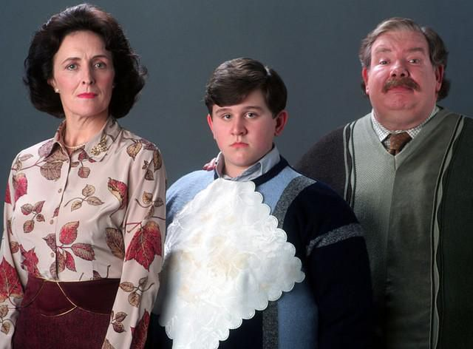
The Dursleys are some of the most unpleasant, judgemental, and snobbish people you could ever meet in a British suburb.
Vernon and Petunia Dursley have a great fear and loathing of magic, which extends to Petunia’s own sister and brother-in-law, Lily and James Potter.
One of the main reasons why Aunt Petunia resented her nephew is that Harry’s mother, Lily, was a witch, and able to attend Hogwarts, whereas Petunia was not. Even if her parents were always proud of her, because she was the “perfect” daughter, and Lily was refered to as a “freak”, her jealousy and, most likely, her feelings of inferiority, lead her to resent her sister and Harry too.
Jealousy

Slide 5
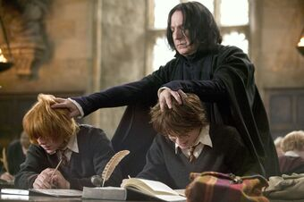
Being bullied by others
One can argue that Snape’s hatred toward
Harry and his bullying him might have also been
related to jealousy, as well as to his own history
of being bullied. Like Harry, Snape had a difficult
childhood.
Snape’s father didn’t know that his wife was a witch when they married, and the two often
fought in front of their child, leaving young Severus without a companion or social support.
When Snape was a student at Hogwarts, he was bullied by James Potter (Harry’s father) and his friends.
Maybe one of the main reasons why James was targeting Snape in the first place was because of Snape’s
friendship with Lily, whom they both liked, so maybe they were jealous.
https://www.youtube.com/watch?v=LHolRZeQNG4

Slide 6
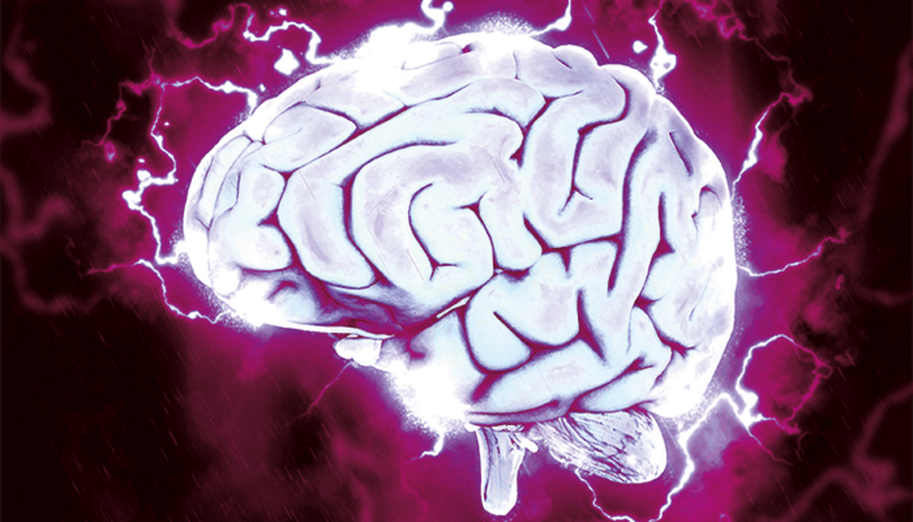
Harry Potter and the Sorcerer’s Stone. Potter and Dudley
The volatile relationship between Harry and Dudley
has always been marked by a constant battle of brain versus
brawn. Harry is unable to challenge his cousin physically,
leaving him with only two weapons: his wits and the threat
of magic.
DUDLEY: Bullying Harry
At home Dudley is spoiled, while Harry is forced to sleep in a cupboard under the stairs.
At School Dudley and his friends love ‘Harry hunting’, and Harry’s glasses are taped together because he’s been punched in the face by the bullies so many times.
HARRY: Taunting Dudley With Magic - The Snake Incident
At the zoo on Dudley’s birthday, the glass in front of a boa constrictor/Burmese python’s enclosure exhibit disappears, frightening everyone. Harry is later punished for this incident. He will taunt Dudley from now on knowing that the Dursleys are terrified of magic. https://www.youtube.com/watch?v=6qqp6PdvoSg

Slide 7
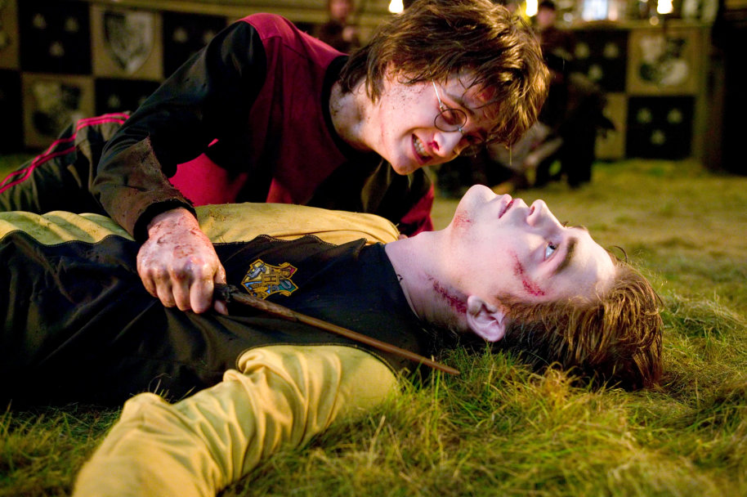
DUDLEY: Taunts About Harry’s Isolation
Due to Harry’s intense isolation Dudley jumps on the opportunity to taunt him about the fact that he has received nothing for his birthday. While Dudley threw a famous tantrum because he only had 36 birthday presents.
https://www.youtube.com/watch?v=GHXSvCMpCGM
DUDLEY: Bullying Harry For His Grief Over Cedric Diggory’s Death
The tragic death of Cedric Diggory at the end of ”Harry Potter and the Goblet of Fire” marked the loss of the house’s most notable student. It also, naturally, traumatized Harry to his very core, after his narrow escape from Voldemort’s clutches.
Dudley ramped up his program of taunting Harry afterwards, as his cousin had been experiencing nightmares and talking in his sleep. This served as perfect insult fodder for him. the Dementor attack in Little Whinging followed and Dudley thought that Harry was casting some kind of spell on him and blamed him for the ordeal.
Interestingly, though, this moment changed Dudley. Under the influence of the Dementor’s powers, he finally recognized how cruelly he had been behaving and was grateful to Harry for saving his life. In their adult lives, the two would share a civil relationship and their children would play together.
https://www.youtube.com/watch?v=zbw4AzqV1Tw

Slide 8
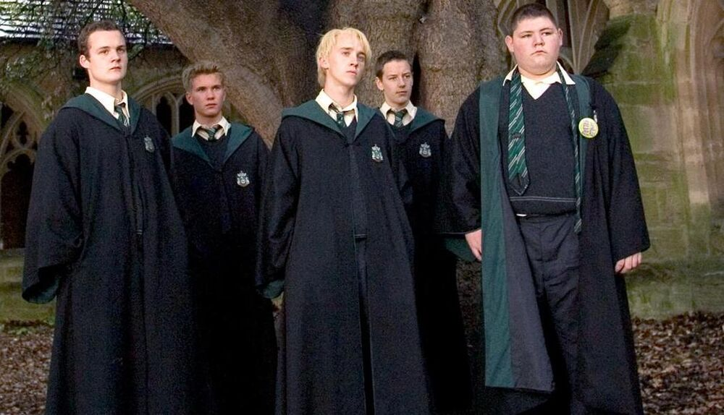
Harry Potter vs Draco Malfoy
Draco Malfoy's gang was a group of Slytherins. Most of them like Crabbe and Gregory hung around Draco Malfoy, the son of a well known Death Eater Lucius Malfoy.
Most of the members were known pure-bloods, using their status in order to assert their dominance as wizards.
The gang generally used their abilities and statuses to bully and terrorise the other students of different houses at Hogwarts, especially the younger students.
Malfoy also used his position as prefect to bully some first years when he got the power in his fifth year. Their main target of hate are Muggle-borns and Blood traitors alike.
For Christmas, Harry receives his father’s invisibility cloak… https://www.youtube.com/watch?v=Puhk_Q6mYCM

Slide 9
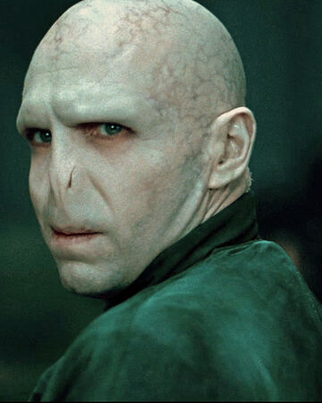
Voldemort (actual name: Tom Riddle) also had a difficult childhood – his mother died in childbirth, and his Muggle father wanted nothing to do with him. Riddle, however, seems to possess traits of Antisocial Personality Disorder (ASPD) :
he’s manipulative;
he lacks empathy toward others and shows no remorse for his wrongdoings;
he’s quite charming and he uses his charm and guile to get his way;
and he will stop at nothing, including murder, to get what he wants.
Dumbledore states on several occasions that the one thing Voldemort doesn’t understand is love. People with ASPD are usually biologically incapable of feeling empathy and compassion toward others; and since these are major components of love, it stands to reason that Voldemort — especially after he split his soul into many pieces — was incapable of love and its related emotions.
We can become compassionate superheroes, proving to Voldemort once again that love is the purest form of magic.
https://www.youtube.com/watch?v=hw6GwhfNl7U
Antisocial
Personality
Disorder (ASPD)

Slide 10
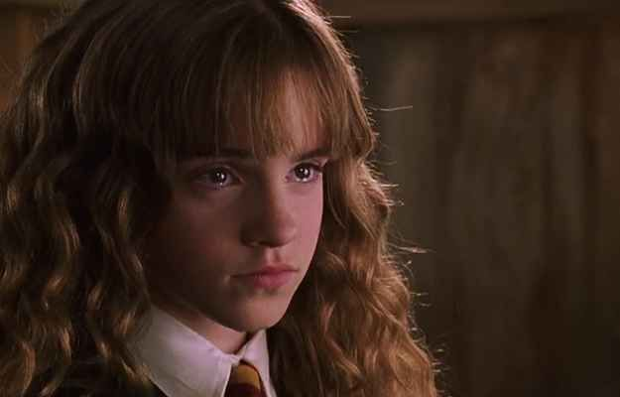
How can we fight Bullying?
Why do we need to read and talk about bullying?
While the series demonstrates different kinds of bullying, prejudice, and abuse, it serves a very important function: it makes us more compassionate.
An act of compassion does not have to be big; it could be a brief supportive message, a smile, or a hug, anything to let the person being bullied know that they are cared for.
Just as Hagrid had supported Hermione, reminding her that “there isn’t a spell our Hermione can’t do” after she was called a “Mudblood” by Draco, so can we stand together and show our support for the person being bullied.

Slide 11
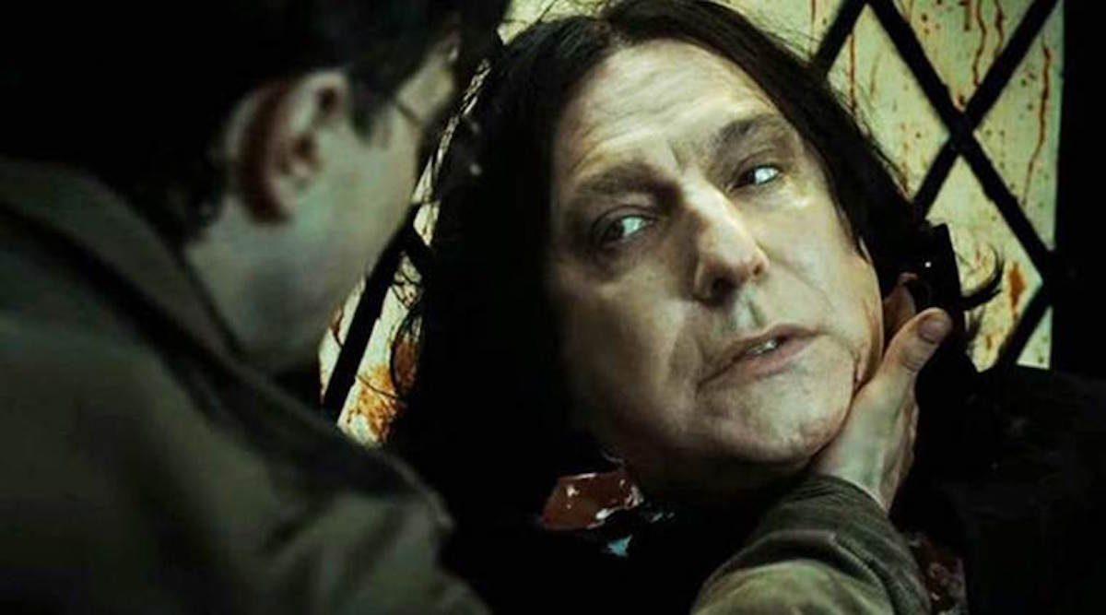
Showing acts of compassion
Compassion is defined as recognizing the suffering of another, being able to put oneself in “another person’s shoes” (empathy), and to want to help this person.
Receiving emotional support from others is crucial in helping us cope with a painful experience. Taking the time to connect with another person makes it more likely that we will be empathic toward them, and can potentially help us heal as well.
Just as Harry supported Snape at his death
https://www.youtube.com/watch?v=NVovWtkGbCc

Slide 12
Now it’s your turn!
In group of 4-5 think of a way to talk of this topic and generate acts of compassion- define your target/ define your main concern/ explain your idea
You can write a story/game/cartoon
You can record a short movie
You can sing a song
You can create a jingle
You can create a questionare
you can create a story on Instagram
you can draw your t-shirt
Each of you need to write a short essay 120-150 words on «Harry Potter’s Saga» and Bullying
a short introduction on bullying-
where the theme was mentioned-
how it was dealt
a personal conclusion

